Slide 1
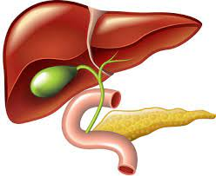
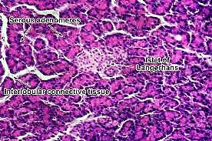
Histology of pancreas

Slide 2
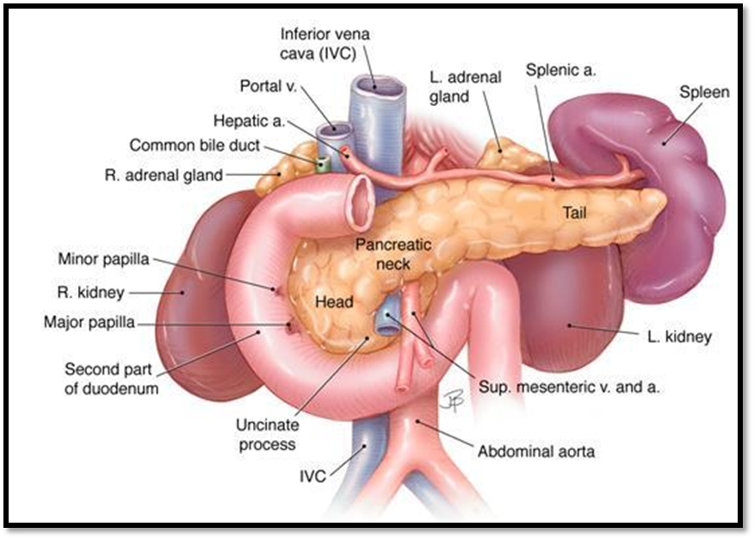
Anatomically
*In domestic species such as dogs and cats, the pancreas is a discrete organ directly adjacent to the duodenum, containing a right (proximal to the duodenum) and left limb.
*In large animals such as horses and cattle, the pancreas has more of a diffuse distribution within the mesentery adjacent to the duodenum.
- Pancreas composed of head , body and tail.

Slide 3
Histological of pancreas
-It is mixed gland : composed of both exocrine(secreted hormones) secreted enzymes) and endocrine parts
-The pancreas has a thin cover of loose connective tissue from which septa pass into the gland, subdividing it into many small lobules.
-Each lobule is again composed of several rounded or tubular groups of pancreatic cells called acini.
-Among the acini are the scattered the islets of langerhans.•
-The acini cells form the parenchyma of the gland which secrete the pancreatic juice.

Slide 4
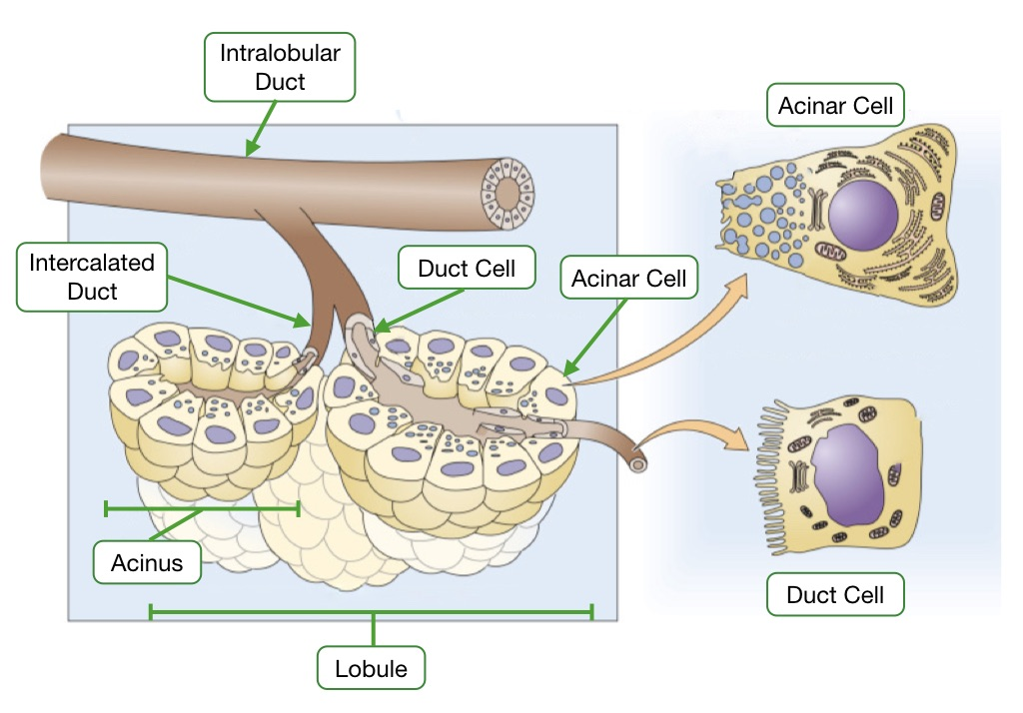
Exocrine pancreas
*It is a compound tubuloalveolar gland.• Composed of:
1- Pancreatic acini.
2-Duct system

Slide 5
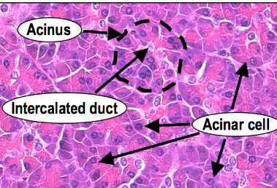
Pancreatic acini
They are serous acini, similar to those of salivary glands (lined by pyramidal cells, with basal basophilia due to abundant rER & apical acidophilia due to zymogen granules), but differ in being:
-Oval in shape.Larger in size.
-Without myoepithelial cells.
-Tightly packed, pressing against one another thus acquiring variable shapes.
-Their lumen is lined by centroacinar cells, that represent the first part of the intralobular ducts (intercalated ducts), that is telescoped inside the lumen of acinus.

Slide 6
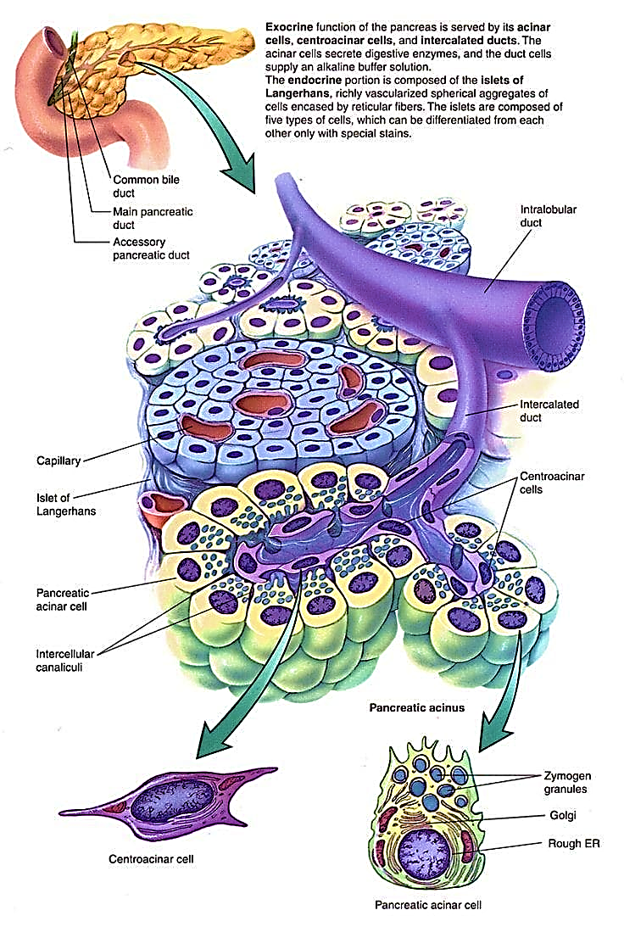
Pancreatic acini

Slide 7
Pancreatic ducts
1-The intralobular ducts (intercalated duct): its proximal part is forming the centroacinar cells. The remaining part is lined by low cuboidal cells.
2- The interlobular ducts: lined by simple cuboidal then simple columnar cells.
3- The main pancreatic duct: lined by simple columnar cells with goblet cells(similar to that of the duodenum where it opens)

Slide 8
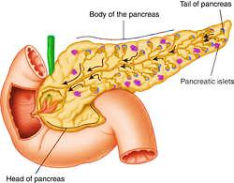
Endocrine pancreas( islets of Langerhans)
The endocrine pancreas is responsible for the
control of blood sugar concentrations, and isolated
groups of pale staining islet cells (pancreatic cells or
the islets of Langerhans) are found scattered among the secretory units.
- More numerous in the head than the body and tail.

Slide 9
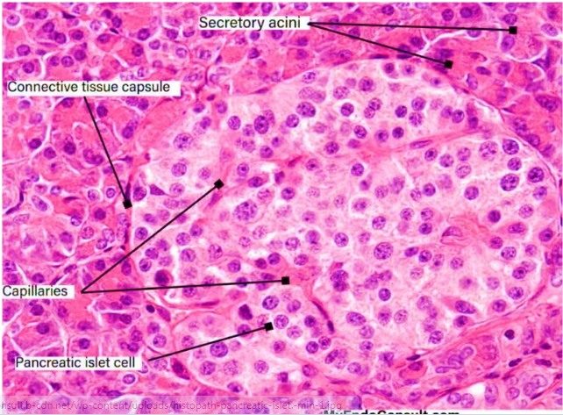
Histological structures of islets of Langerhans
1-Stroma:
➤ Supported by network of reticular fibers.
2-Parenchyma:•
LM:
Shape of the cells: polygonal with pale basophilic cytoplasm.
Arrangement as in a short cords and separated by network of fenestrated blood capillaries.
.

Slide 10
Histological structures of islets of Langerhans
poly peptide secretion )) TEM
-cell in Langerhans islet
-the nuclear shape (N)
-mitochondrial (M),
-rough endoplasmic reticulum (RER),
-Golgi body (G)
-secretory granules (SG)

Slide 11
Types of cells of islets of Langerhans
These have two main cell
types:
*Type A, or alpha, cells secreting glucagon (a polypeptide hormone secreted in response to hypoglycemia or to stimulation by growth hormone);
* Type B, or beta, cells secreting insulin (a peptide hormone
released into the blood in response to a rise in concentration of blood glucose or amino acids).
*Rare
*D, or delta, cells secrete somatostatin
*F cells secrete pancreatic polypeptide

Slide 12
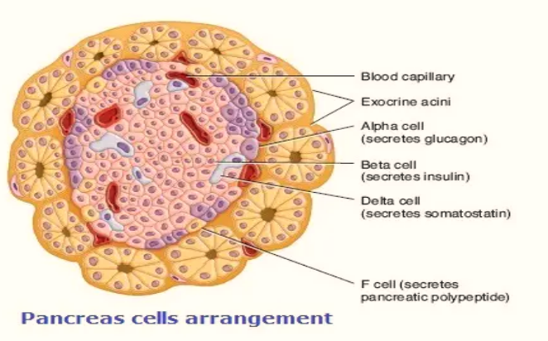
1-A or alpha cells
• Function: secretion of glucagon increase blood sugar level.
• Size: large.
• Number: 20%.Site: at the periphery of the islet.
EM: the secretory granules are numerous and have a homogeneous dense core

Slide 13
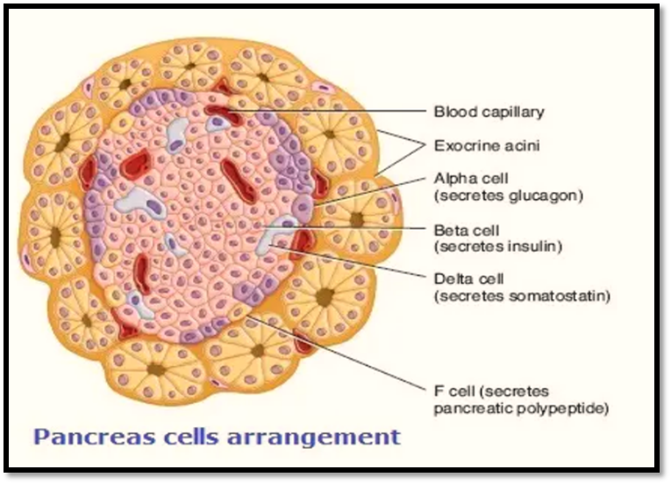
2- B or Beta cells
• Functions:
1- Secretion of insulin lower blood sugar level.
2- Secretion of C-peptide
3-Secretion of GABA (y amino butyric acid): suppress glucagon secretion.
• Size of the cells: small.
• Number: 70% of the islet cells.
•Site: centrally located within the islet.
⚫ EM: their secretory granules have a rectangular crystalline dense core surrounded by an electron lucent halo.

Slide 14
3- D or delta cells
• Function: secretion of somatostatin inhibits secretion of GH, insulin & glucagon.
• Number: 5-10% of the islet cells.
• Site: at the periphery of the islet

Slide 15
4-F cells (PP)
function :
cells secrete pancreatic polypeptide Number :constitute <5% of the islet cells.
Site : periphery
They are mostly located within the head of the pancreas.

Slide 16
TEM
Electron micrograph of the Langerhans islet of Langerhans islet cells are situated surrounding a capillary (Cap), secretory granules. Insulin secretory granules of the β-cell (β) are ,Glucagon secretory granules of the α-cell (α), Somatostatin-containing granules of the δ-cell (δ) PP-cells (PP) contain spherical or elliptical small granules, which are very heterogeneous in size

Slide 17
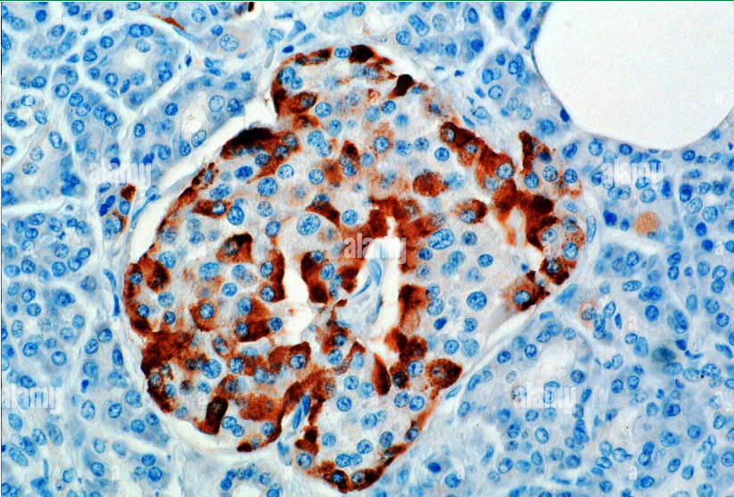
Glucagon: Immunoperoxidase staining of normal formalin-fixed, paraffin-embedded, pancreas showing cytoplasmic staining of islet alpha cells

Slide 18
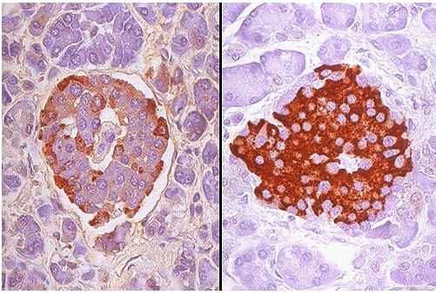
Immunoperoxidase staining can help identify the nature of the cells present in the islets of Langerhans. On the right, antibody to insulin has been employed to identify the beta cells. On the left, antibody to glucagon identifies the alpha cells

Slide 19
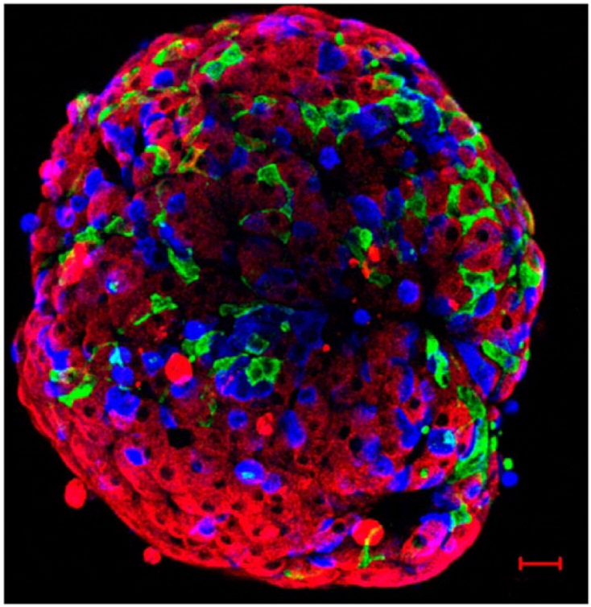
Mouse islet immunolabelled for insulin (red), glucagon (blue), and somatostatin (green). This confocal image reconstruction of the cells at the exterior of the islet demonstrates the network of δ-cells and their proximity to α- and β-cells.

Slide 20
Pancreatic islets demonstrating the species-specific differences in cellular architecture. Immunofluorescent labelling of pancreatic sections for insulin (green), glucagon (pink), and somatostatin (yellow).

Slide 21
1
3
2
Pancreas (dog). (1) Serous acinus with a centroacinar cell (arrowed). (2) Interlobular connective tissue. (3) Interlobular duct. H & E 125x

Slide 22
1
2
Pancreatic islet. Pancreas (cat). (1) Pale staining endocrine cells form cords associated with capillaries.
(2) Exocrine acinus. H & E. ×125.

